Slide 1
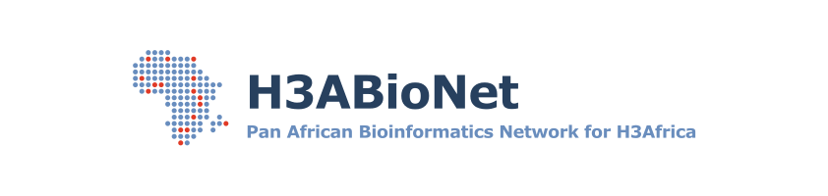

16SrRNA Intermediate Bioinformatics Online Course: Int_BT_2019
16S downstream analyses in R

Slide 2
Microbial diversity estimates
Bacterial diversity can be estimated
single sample measure (alpha diversity) or
between samples similarity (beta diversity)
A
B
C

Slide 3
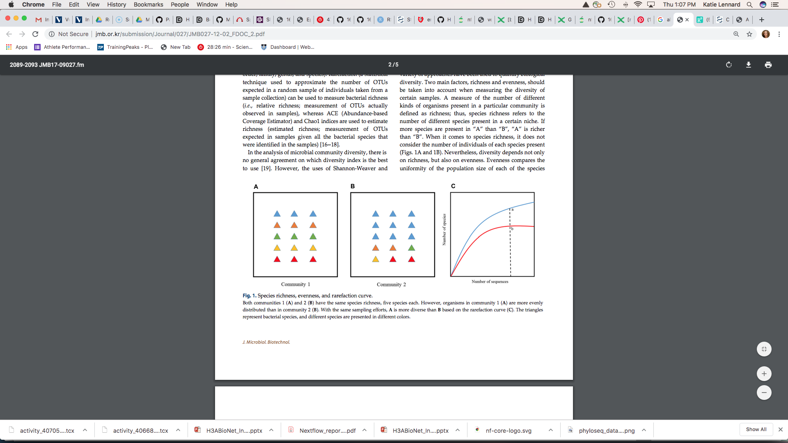
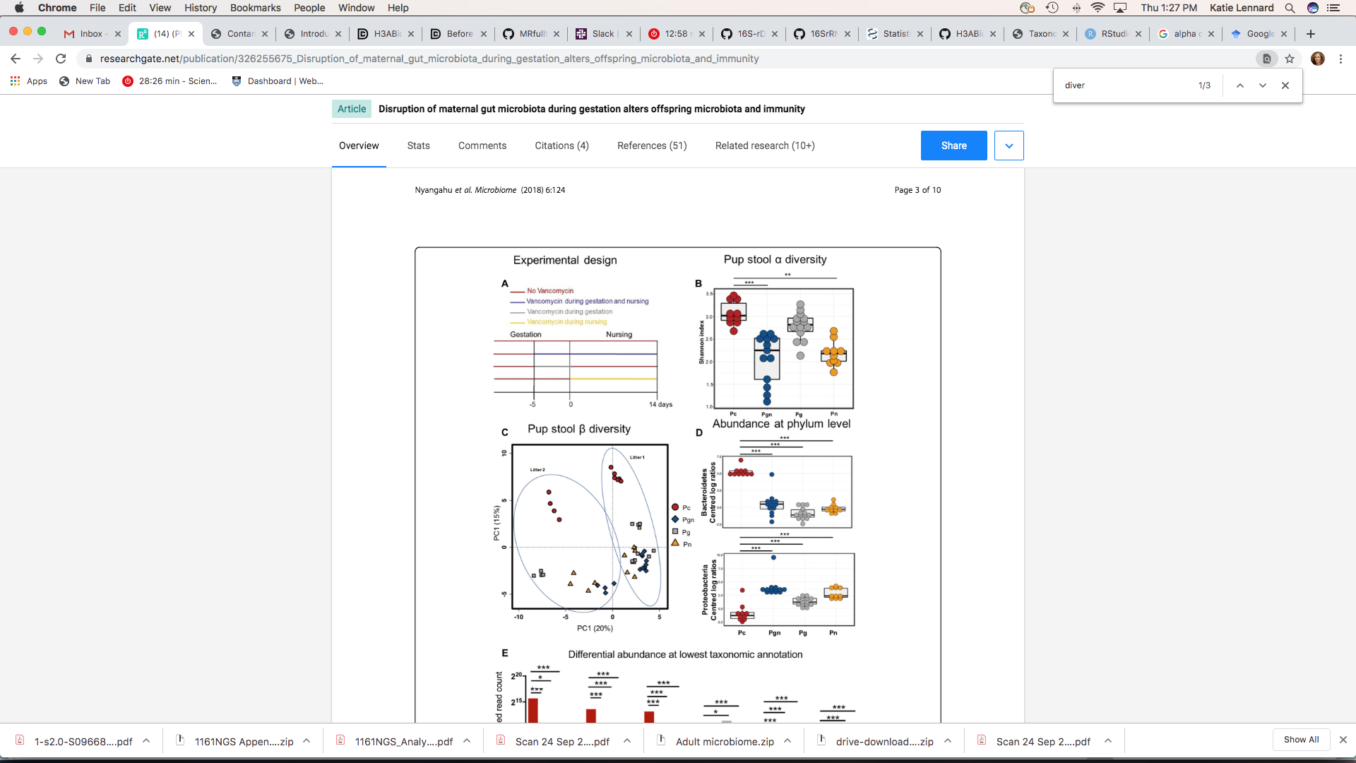
Alpha diversity metrics
Measure of within-sample richness and evenness
Why useful?
Microbiota diversity often related to biological outcomes
Community 1 vs. 2: Same richness (number of distinct taxa), different evenness
[1] http://www.jmb.or.kr/submission/Journal/027/JMB027-12-02_FDOC_2.pdf
https://doi.org/10.1186/s40168-018-0511-7

Slide 4
Alpha diversity metrics
Alpha diversity metrics that incorporate richness & evenness
Shannon
places greater weight on richness
Simpson
places greater weight on evenness
Abundance-based measures of richness
Chao1: non-parametric method for estimating the number of species in a community
uses singletons, doubletons to estimate number of missing species
does not account for misclassification uncertainty?
NB: don’t use with dada2 as dada2 automatically removes singletons: “DADA2 does not call singletons because of how difficult it is to robustly distinguish between real singletons and singleton errors”

Slide 5
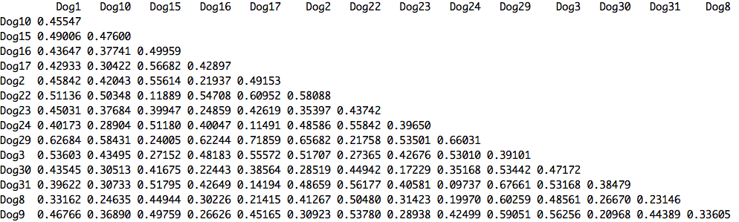
Beta diversity metrics
First calculate pairwise dissimilarity between samples

Slide 6
Beta diversity metrics
…then plot this dissimilarity matrix as an ordination
Ordination: “a term used in ecology to refer to several multivariate techniques for visualization of species abundance in a low-dimensional space” [1]
Position samples in a space of reduced dimensionality while preserving their distance relationships as well as possible

Slide 7
Beta diversity metrics
Suitable distance metrics for 16S (ecological) data should consider:
Abundance
Composition
Phylogenetic relatedness
Why not Euclidean?
if you’re comparing two samples certain species may be absent/zero in both samples – Euclidean distance would make these two samples look more similar even though this may not be the case

Slide 8
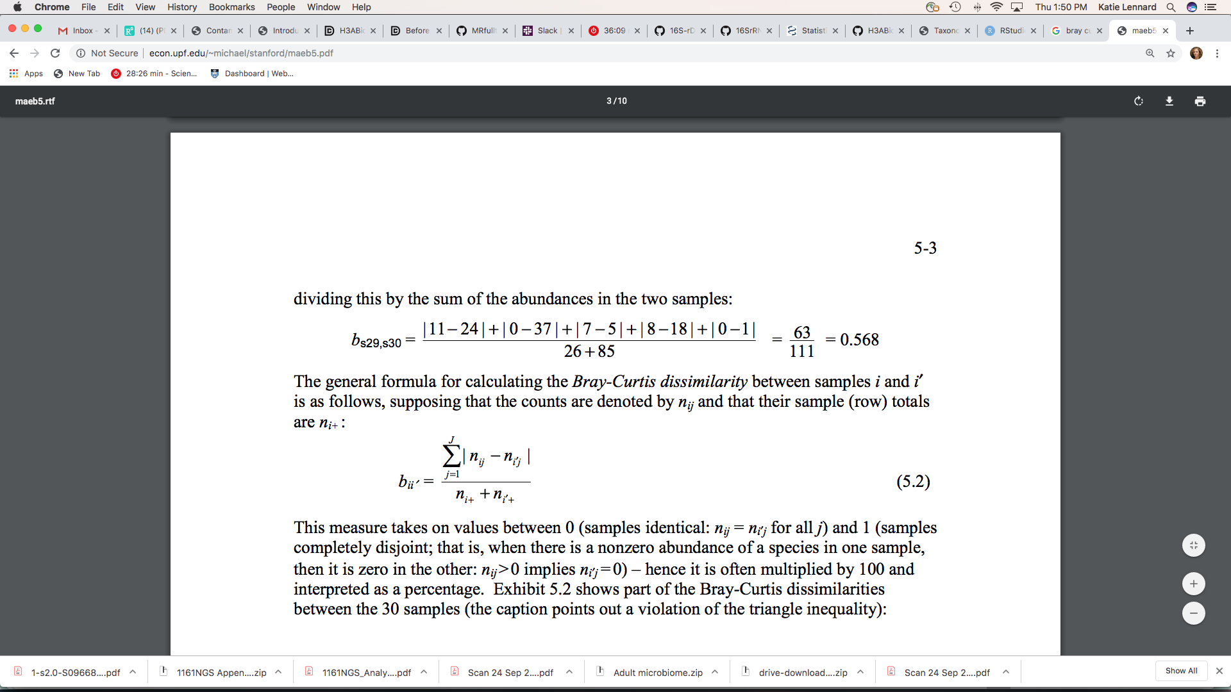
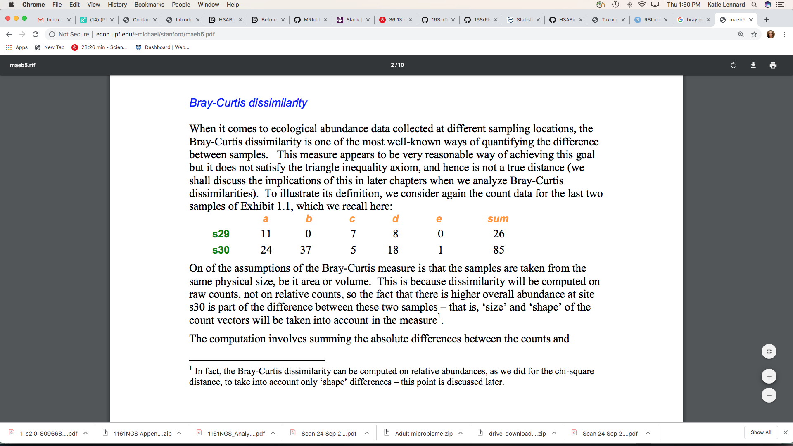
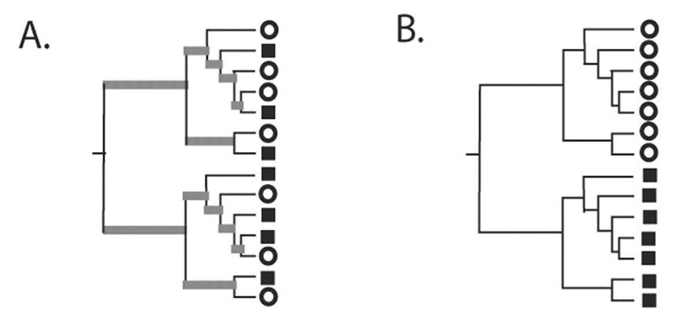
Beta diversity metrics
Bray-Curtis dissimilarity
Unifrac distance
Measure of phylogenetic relatedness
Weighted Unifrac:
phylogeny + abundance (quantitative)
https://aem.asm.org/content/aem/71/12/8228.full.pdf
Notes:
BC: The computation involves summing the absolute differences between the counts and dividing this by the sum of the abundances in the two samples
Unifrac: Calculation of the UniFrac distance metric. Squares, triangles, and circles denote sequences derived from different communities. Branches attached to nodes are colored black if they are unique to a particular environment and gray if they are shared. (A) Tree representing phylogenetically similar communities, where a significant fraction of the branch length in the tree is shared (gray). (B) Tree representing two communities that are maximally different so that 100% of the branch length is unique to either the circle or square environment.

Slide 9
Ordination methods
Multidimensional scaling (MDS) = Principal coordinates analysis (PCoA)
Principal components analysis (PCA): simplest case of MDS where the dissimilarity metric is Euclidean distance (which is not appropriate for ecological data)
Axes measure of importance (% variation explained)
Non-metric MDS (NMDS)
Iterative method (non-metric) converting raw dissimilarity values into ranks
NB: iterative so random start seed should be recorded
Locates samples in N-dimensional space so that Euclidean distance (in ordination) between samples correspond to compositional dissimilarity (calculated by Bray-Curtis, Unifrac etc.)
Stress value: measure of fit between ordination and input dissimilarity (lower is better, with 0.1 as ballpark minimum acceptable)
Should I use MDS or NMDS?
NMDS is better than MDS if MDS requires 3 or more dimensions to represent the main distance relationship among sites. NMDS is able to ‘squeeze’ (distort) the ordination into two dimensions (which is useful for publication purposes)

Slide 10
Annotated heatmaps

Slide 11
Differential abundance testing
Suitable methods should consider:
Zero-inflated nature of 16S data
Differences in sampling depth between samples
Non-parametric tests like Wilcoxon rank-sum or Kruskal-Wallis?
More powerful parametric alternatives:
DESeq2
edgeR
MetagenomeSeq
Specifically designed for zero-inflated count data with variable coverage between samples
Generalized linear model with zero-inflated Gaussian distribution (abundance testing) + presence/absence statistic (Fisher’s exact)
Originally designed for RNASeq data
Both fit a generalized linear models and assume that read counts follow a Negative Binomial distribution.
Notes:
Both fit a generalized linear model and assume that read counts follow a Negative Binomial distribution. The NB distribution extends the Poisson distribution by allowing the variance to be different from the mean. edgeR and DESeq2 mainly differ in the way they normalize the data. DESeq2 uses size factors that account for differences in sequencing depth between samples and shrinkage for large variances correction. edgeR can be implemented with different normalization methods but the most recommended is TMM, the trimmed mean of M-values normalization method, that indirectly attempts to overcome the problem of compositional DNA sequencing data ("the proportion of reads attributed to a given gene in a library depends on the expression properties of the whole sample rather than just the expression level of that gene") - https://www.ncbi.nlm.nih.gov/pmc/articles/PMC6459172/

Slide 12
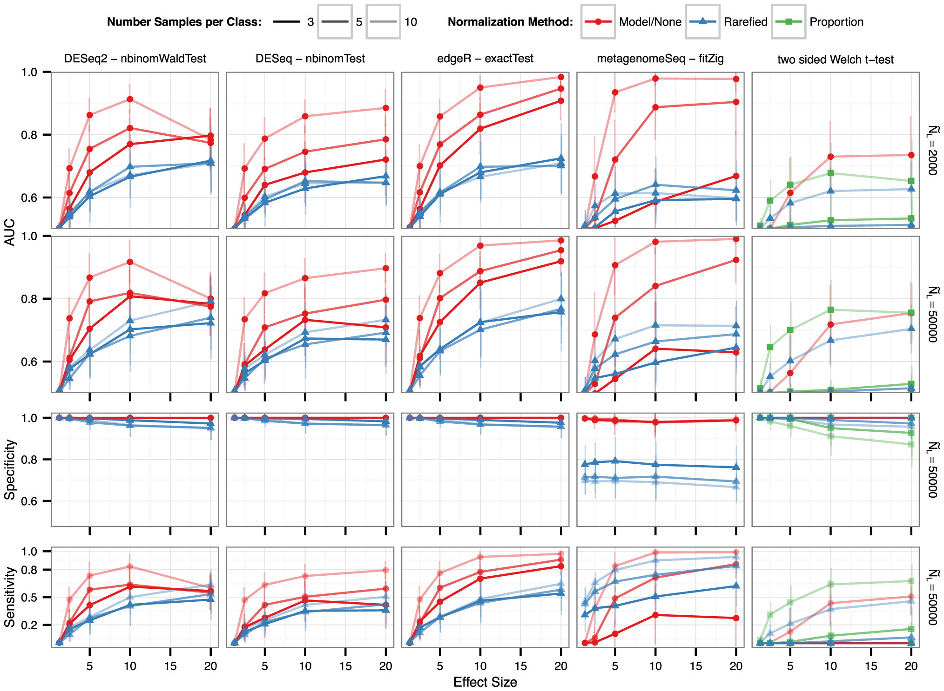
Differential abundance testing: method comparison
https://doi.org/10.1371/journal.pcbi.1003531
Notes:
Performance summarized here by the “Area Under the Curve” (AUC) metric of a Receiver Operator Curve (ROC) [59] (vertical axis). Briefly, the AUC value varies from 0.5 (random) to 1.0 (perfect), incorporating both sensitivity and specificity. The horizontal axis indicates the effect size, shown as the actual multiplication factor applied to OTU counts in the test class to simulate a differential abundance. Each curve traces the respective normalization method's mean performance of that panel, with a vertical bar indicating a standard deviation in performance across all replicates and microbiome templates. The right-hand side of the panel rows indicates the median library size, , while the darkness of line shading indicates the number of samples per simulated experiment. Color shade and shape indicate the normalization method. See Methods section for the definitions of each normalization and testing method. For all methods, detection among multiple tests was defined using a False Discovery Rate (Benjamini-Hochberg [52]) significance threshold of 0.05

Slide 13
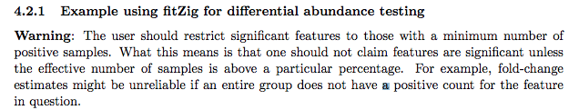
metagenomeSeq
Normalization method accounts for differences in sampling depth (cumulative sum scaling)
Zero-inflated GLM computes probability of zero due to:
low sampling depth (present but not observed) vs.
sparsity (biological zero, truly absent)
Can include covariates (prevent confounding)
Results require filtering based on ASV presence to avoid false positives, particularly with small sample sizes
Further reading

